Slide 1

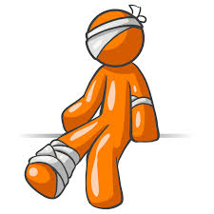



AMBULANCE
PAIN/HURT
POLICE
FIRE
I’M SICK
BAD WEATHER
HELP/EMERGENCY

Slide 2

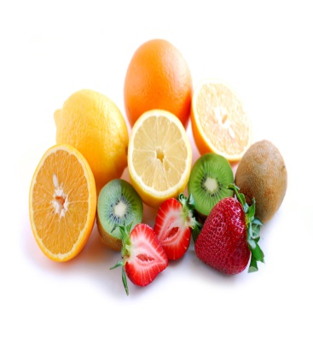
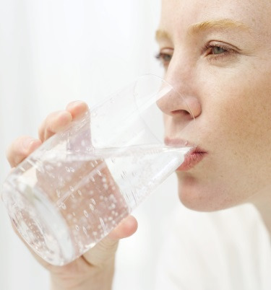
SANDWICH
JUICE
FRUIT
BREAKFAST
DINNER
WATER
I WANT….

Slide 3


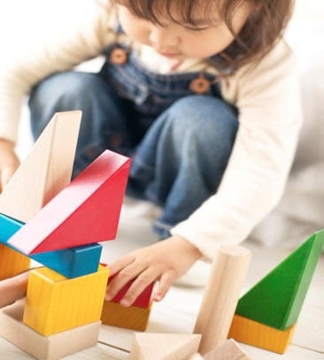
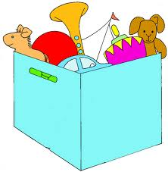
WATCH TV
EXERCISE
SWING
PLAY WITH BLOCKS
RIDE BICYCLE
WITH TOYS
LET’S PLAY…

Slide 4

READING
MATH
SCIENCE
WRITING
COLORING
MUSIC
SCHOOL/EDUCATION

Slide 5

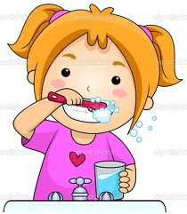
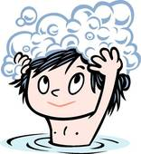

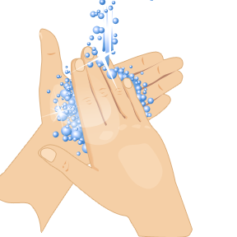
BRUSHIG TEETH
TAKE BATH
WASH HAIR
CLEAN CLOTHES
WASH FACE
WASHING HANDS
CLEANLINESS

